Slide 1
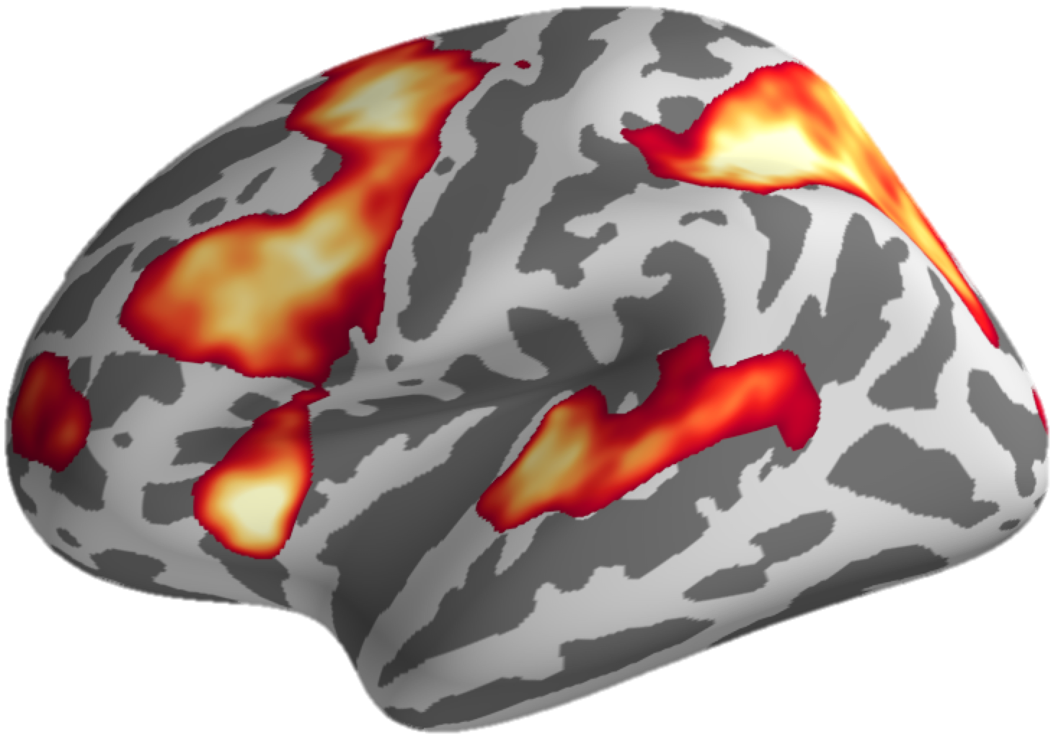

Computational Modeling of Human Perceptual Decision-Making
Ru-Yuan Zhang(张洳源)
Institute of Psychology and Behavioral Sciences
Shanghai Mental Health Center
2022/12/10

Slide 2





Who am I ?
2006–2010, B.S., Psychology and Computer Science, Peking University.
2010–2016, Ph.D., Brain&Cognitive Sciences, University of Rochester.
2016–2020, Postdoc, Center for Magnetic Resonance Research, University of Minnesota at Twin Cities.
2020.01-09, Postdoc, Section on Functional Imaging Methods, NIMH, NIH.
2020.09-present, Associate Professor, Shanghai Jiao Tong University

Slide 3



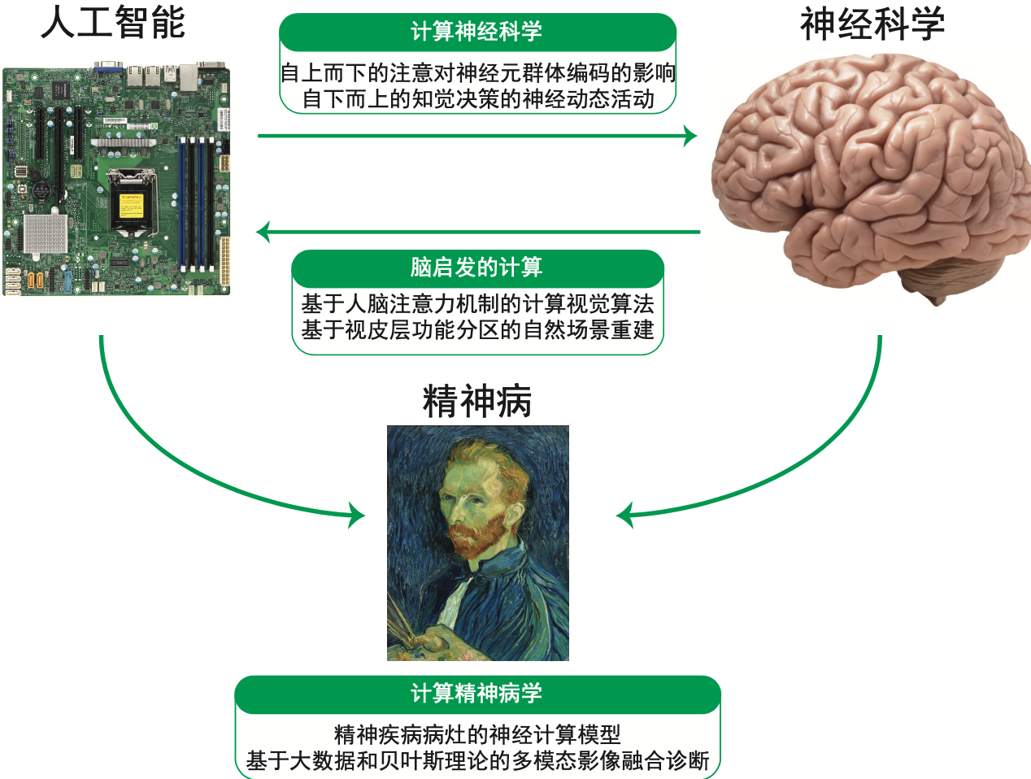

Who am I ?
Research directions
Cognitive Computational Neuroscience
Deep Learning and Human Vision
Computational Psychiatry
Associate Professor, Principal Investigator
Laboratory of Cognitive Computational Neuroscience and Neuroimaging
https://ruyuanzhang.github.io

Slide 4
Perceptual Decision-Making
Goal: hands-on model fitting practice on perceptual decision-making
Content:
Section 1: modeling simple perceptual choice
Section 2: modeling perceptual choice and reaction time

Slide 5
Section 1
Modeling simple perceptual choice

Slide 6
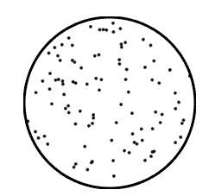
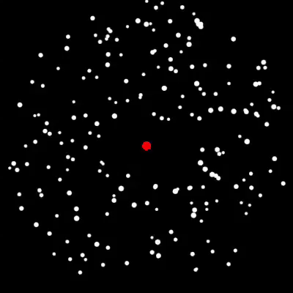
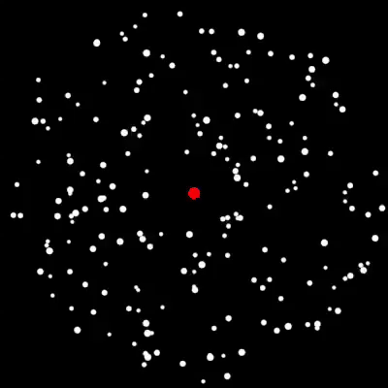
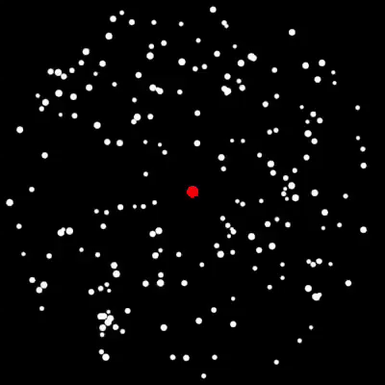
Section 1
Simple perceptual decision making
Coherence Level: fraction of dots coherently moving to one direction
Random dot motion (RDM)
100%
50%
10%
Right
Right
Left
Easy
Hard

Slide 7

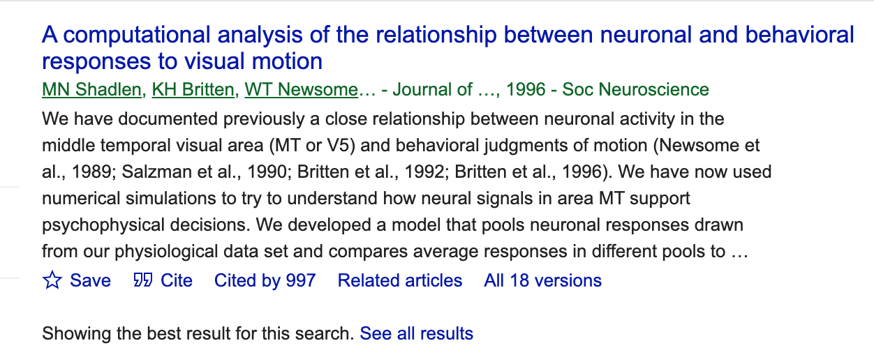
Perceptual Decision-Making

Slide 8
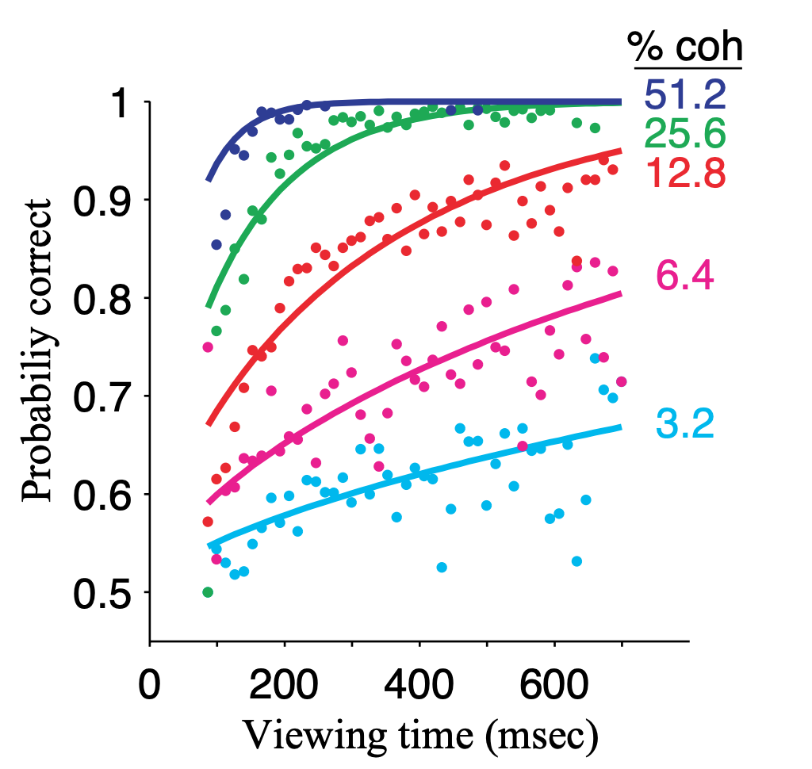
Perceptual Decision-Making
Higher coherence, higher accuracy
Longer duration, higher accuracy

Slide 9
Perceptual Decision-Making
How can we model such a simple perceptual effect??

Slide 10
Perceptual Decision-Making
A simple model of perceptual decision-making
(pdm1.ipynb)

Slide 11
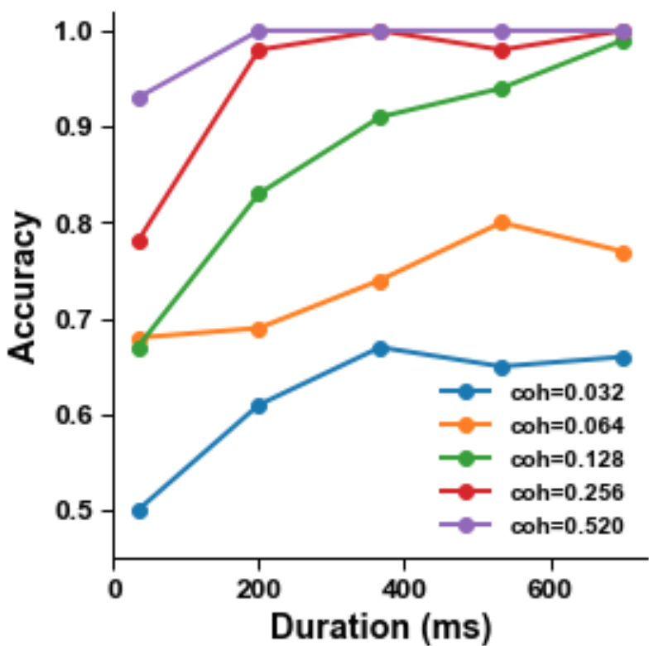
Perceptual Decision-Making
Empirical data
A simple perceptual model
Higher coherence, higher accuracy
Longer duration, higher accuracy
The subject makes a decision by counting dots moving to left/right
In real experiments, we test many coherence levels and many stimulus durations in many trials

Slide 12
Section 2
Modeling perceptual choice and reaction time

Slide 13
Section 2
Simple perceptual decision making
Coherence Level: fraction of dots coherently moving to one direction
Random dot motion (RDM)
100%
50%
10%
Right
Right
Left
Easy
Hard

Slide 14
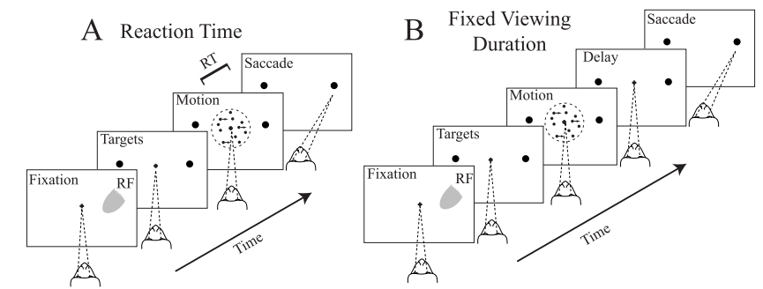
Perceptual Decision-Making
Roitman&Shadlen, J. Neurosci. 2002

Slide 15
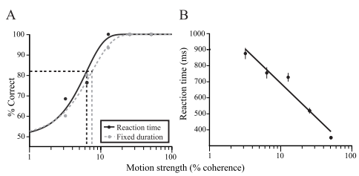
Perceptual Decision-Making
Roitman&Shadlen, J. Neurosci. 2002

Slide 16
Perceptual Decision-Making
Drift diffusion model (DDM)
DDM is one of the most frequently used models in perceptual decision-making

Slide 17
What is drift-diffusion?
Evidence accumulation
Drift-diffusion
Decision boundary
A simple illustration of drift-diffusion process
(pdm2.ipynb)

Slide 18
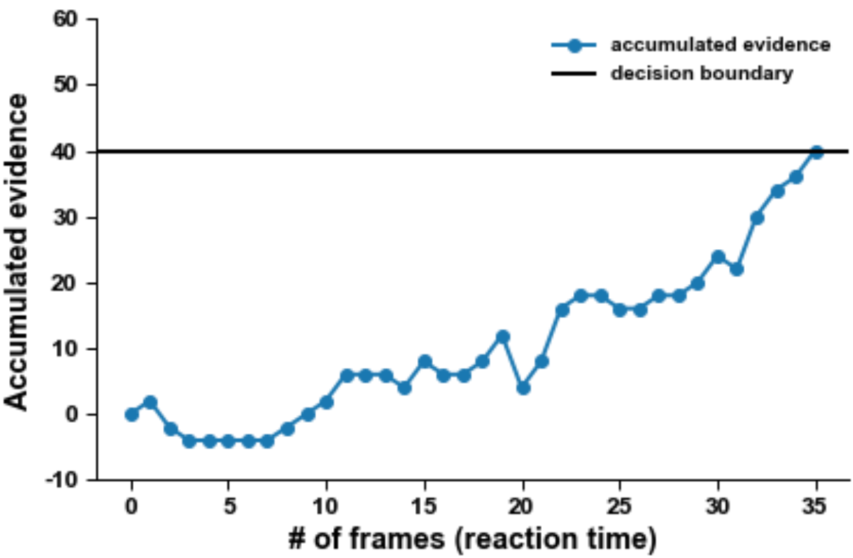
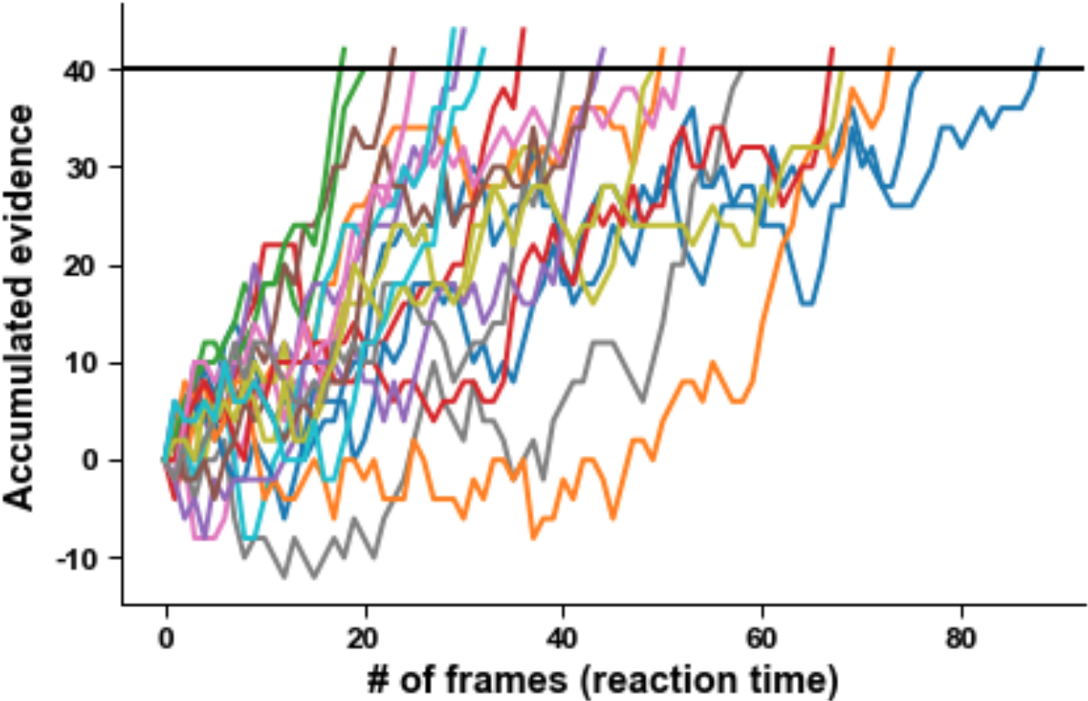
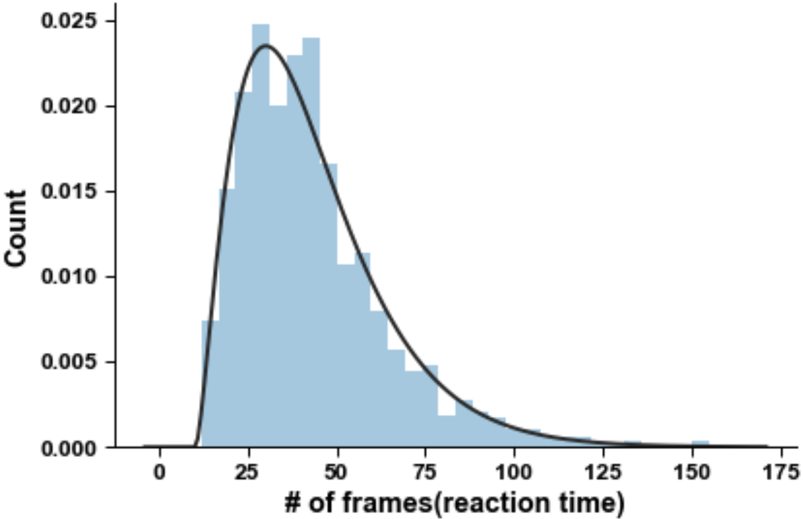
drift-diffusion models
Summary
We calculate sensory evidence in each frame
The over sensory evidence accumulates as a drift-diffusion process
A choice is triggered when accumulated evidence reaches a fixed decision boundary
The reaction distribution bears strong resemblance to the empirical reaction time data

Slide 19
Speed-accuracy trade-off
Higher coherence, Higher accuracy, shorter reaction time
Accuracy and reaction time are negatively correlated

Slide 20
Speed-accuracy trade-off
Conservative decision-maker
High accuracy but long reaction time
Impulsive decision-maker:
Short reaction time but low accuracy
Speed-accuracy trade-off !!!
Can drift-diffusion model account for speed-accuracy trade-off?
(pdm3.ipynb)

Slide 21
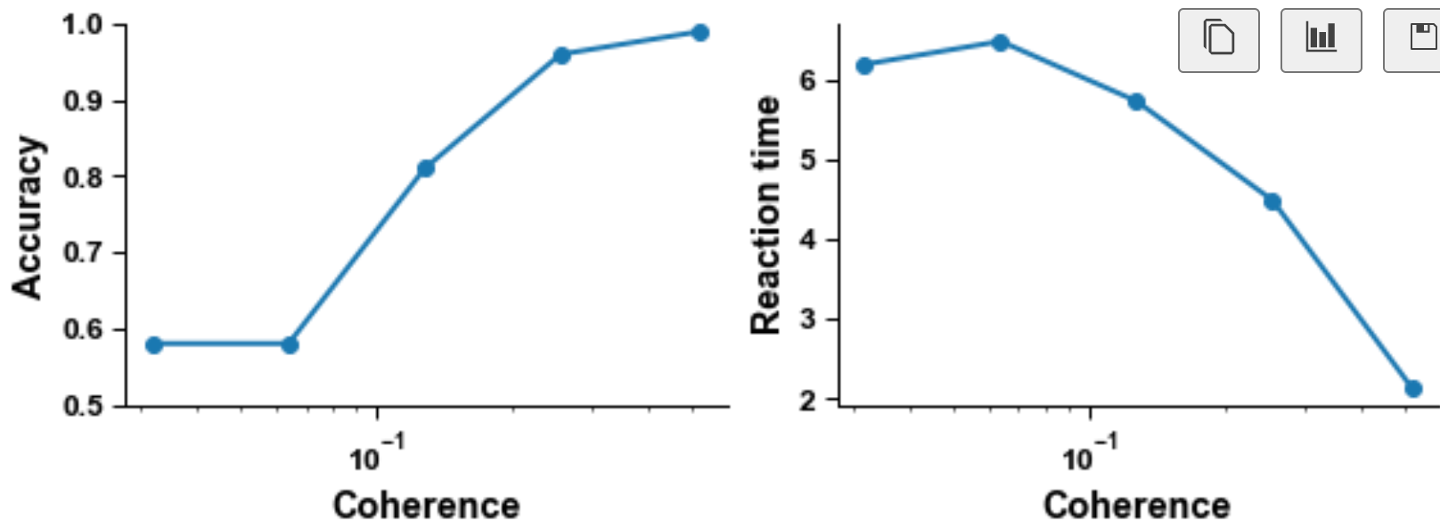
Speed-accuracy trade-off
Empirical data
Our drift-diffusion model

Slide 22
Section 2-Summary
We calculate sensory evidence in each frame
The over sensory evidence accumulates as a drift-diffusion process
A choice is triggered when accumulated evidence reaches a fixed decision boundary
The reaction distribution bears strong resemblance to the empirical reaction time data
Drift-diffusion model can well account the speed-accuracy tradeoff in perceptual decision making
Decision impulsivity is associated with decision bounds
impulsive = low decision bound
conservative = high decision bound

Slide 23
Section 2-real data
How can we perform drift-diffusion modeling in real data?
(PDM4.ipynb)

Slide 24
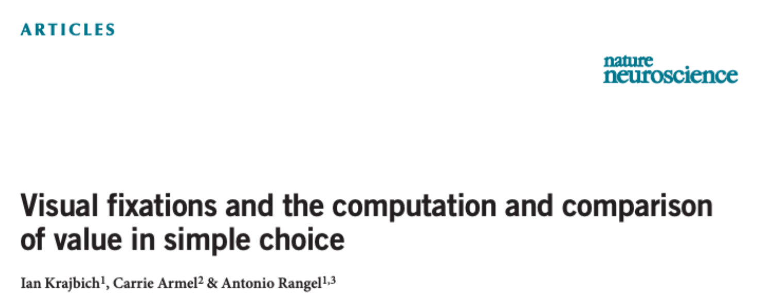
Applications-consumer decisions
Consumer decisions

Slide 25
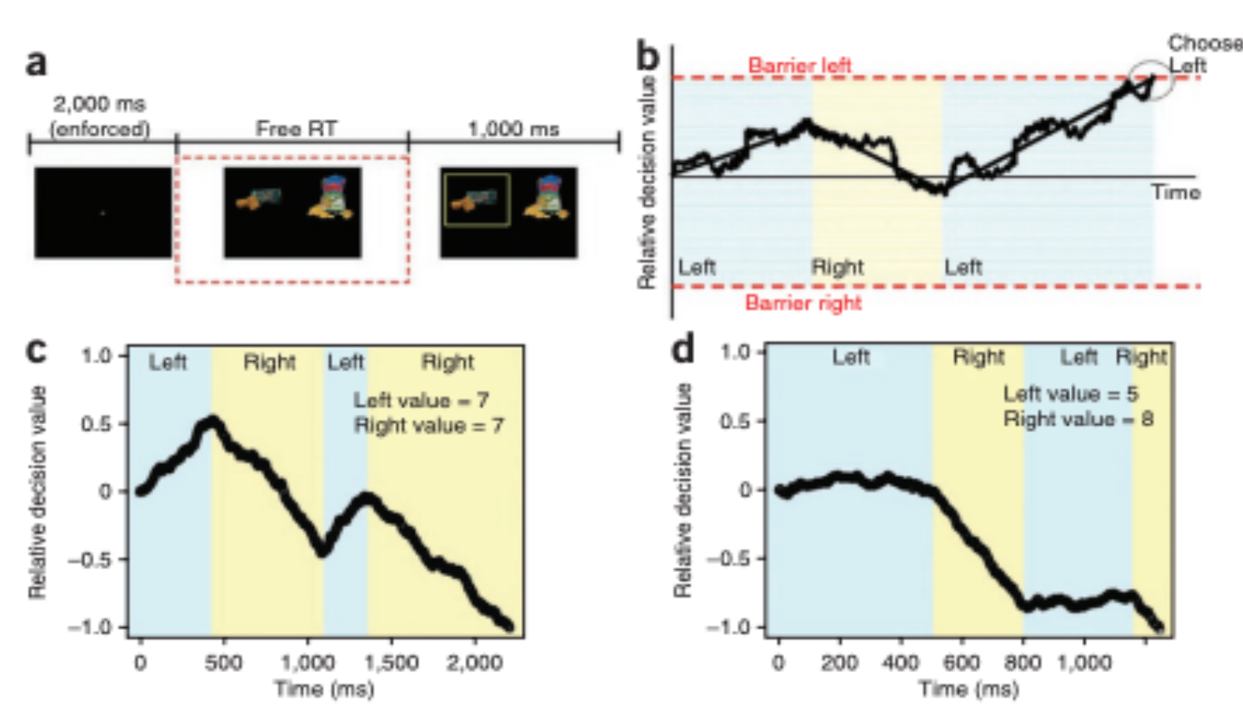
Applications-consumer decisoins

Slide 26
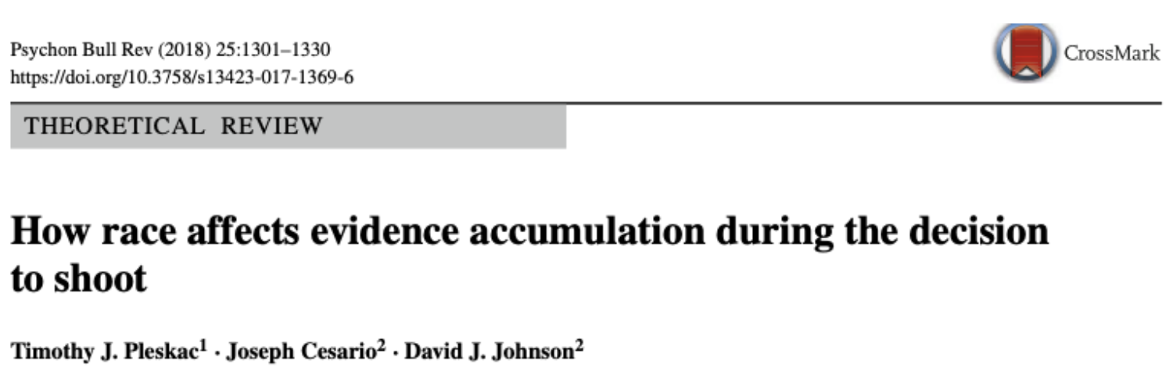
Applications-social decisions

Slide 27
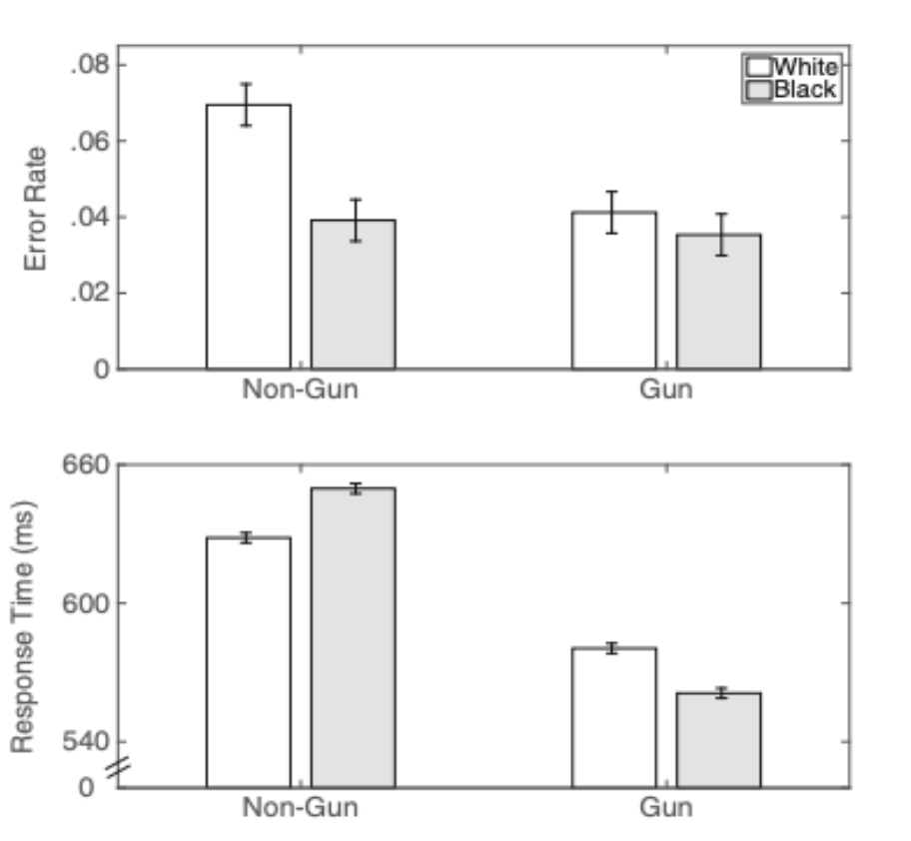
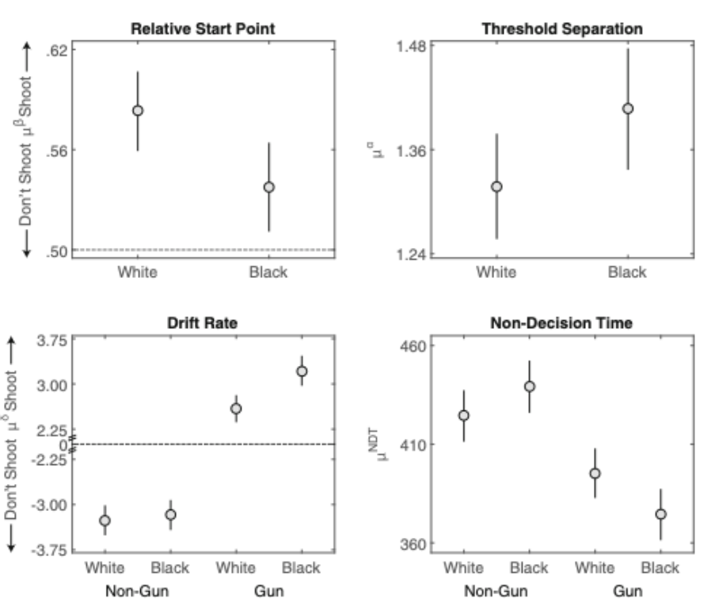
Applications-social decisions

Slide 28
Perceptual Decision-Making
Section 1: modeling perceptual choice
The subject makes a decision by counting dots moving to left/right
In real experiments, we test many coherence levels and many stimulus durations in many trials
Section 2: modeling perceptual choice and reaction time
We calculate sensory evidence in each frame
The over sensory evidence accumulates as a drift-diffusion process
A choice is triggered when accumulated evidence reaches a fixed decision boundary
Drift-diffusion model can well account the speed-accuracy tradeoff in perceptual decision making
Decision impulsivity is associated with decision bounds
impulsive = low decision bound
conservative = high decision bound

Slide 29
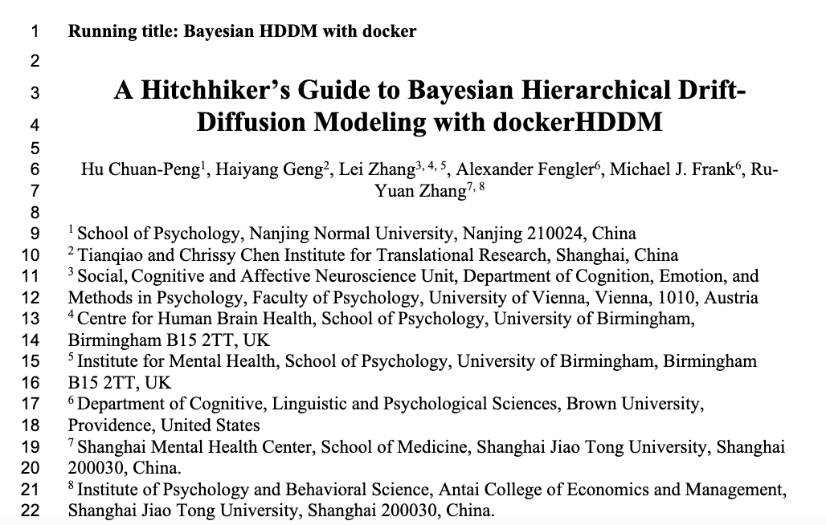
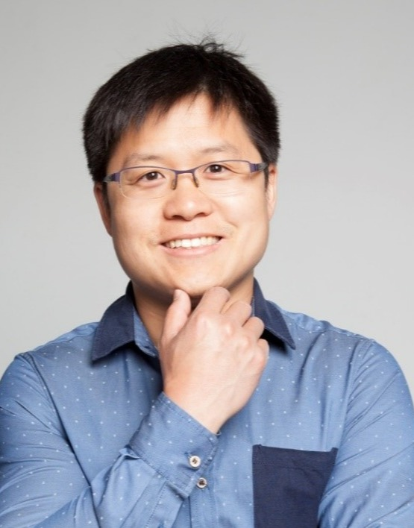
Advanced materials
Multi-subjects hierarchical drift-diffusion modeling
A easy-to-use docker image
Preprint: https://psyarxiv.com/6uzga
Github: https://github.com/hcp4715/dockerHDDM
dockerhub: https://hub.docker.com/r/hcp4715/hddm
Chuan-Peng Hu, Professor
Nanjing Normal University

Slide 30




Acknowledgments
Teaching Materials
Prof. Robert Wilson (U Arizona): http://u.arizona.edu/~bob/web_NSCS344/
Prof. Brenden Lake (NYU): https://brendenlake.github.io/CCM-site/
Collaborators
Chuan-Peng Hu
Nanjing Normal University
Lei Zhang
Univ. Birmingham
Haiyang Geng
TCCI
Alexander Fengler
Brown
Michael Frank
Brown

Slide 31
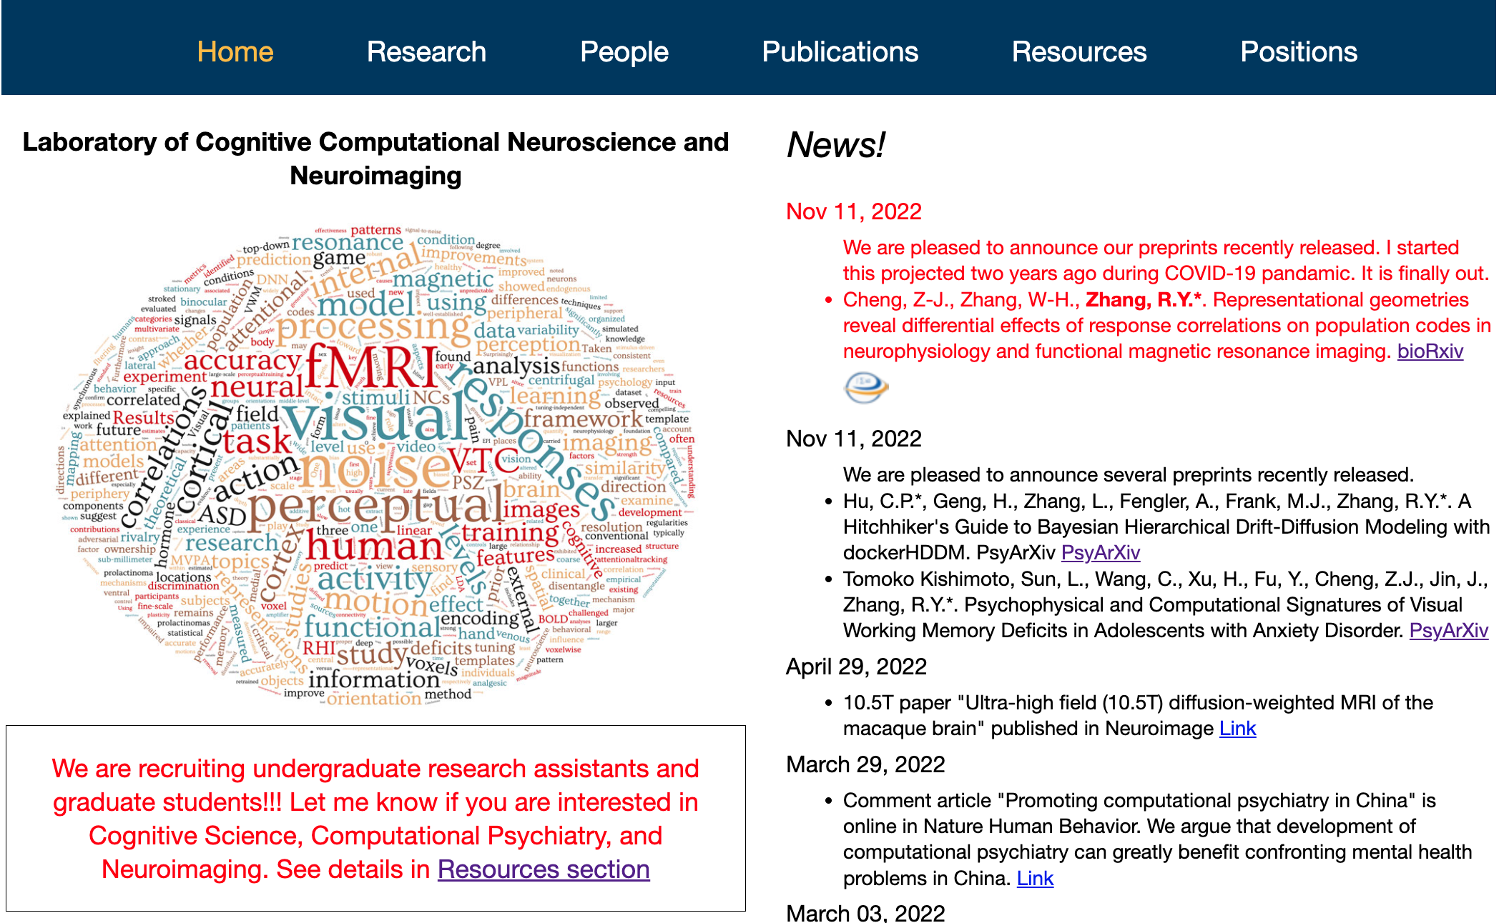
Concluding remarks
This tutorial: https://github.com/ruyuanzhang/20221210_CITUWORKSHOP
Lab page: https://ruyuanzhang.github.io/
We hire Postdoc!
Cognitive neuroscience, computational neuroscience, neuroimaging

